Slide 1
Introduction to SQL

Slide 2
Basic introduction of dbms:
Data: Data refers to any piece of information. It can be numbers, words, images, sounds, or any other information that a computer can store and process. Data can be raw or processed.
Database: The database is a collection of inter-related data which is used to retrieve, insert and delete the data efficiently. It is also used to organize the data in the form of a table, schema, views, and reports, etc. Ex-The college Database organizes the data about the admin, staff, students and faculty etc.
The primary function of DBMS is to define data structure, manipulate data, giving access control of data, backup and recovery.

Slide 3
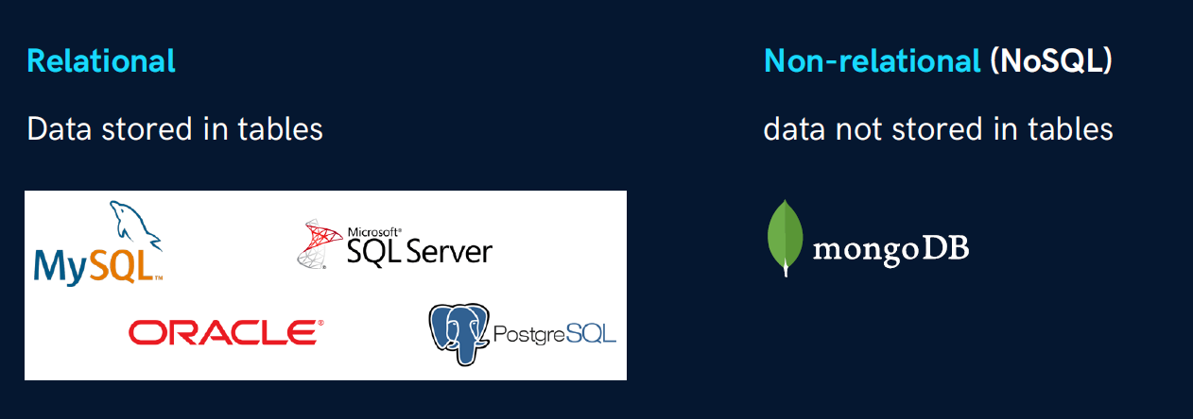
Types of Databases:

Slide 4
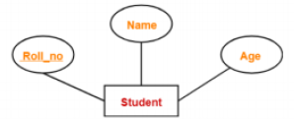
ER diagram:
ER diagram or Entity Relationship diagram is a conceptual model that gives the graphical representation of the logical structure of the database.
● It shows all the constraints and relationships that exist among the different components.
● An ER diagram is mainly composed of following three components- Entity Sets, Attributes and Relationship Set.

Slide 5
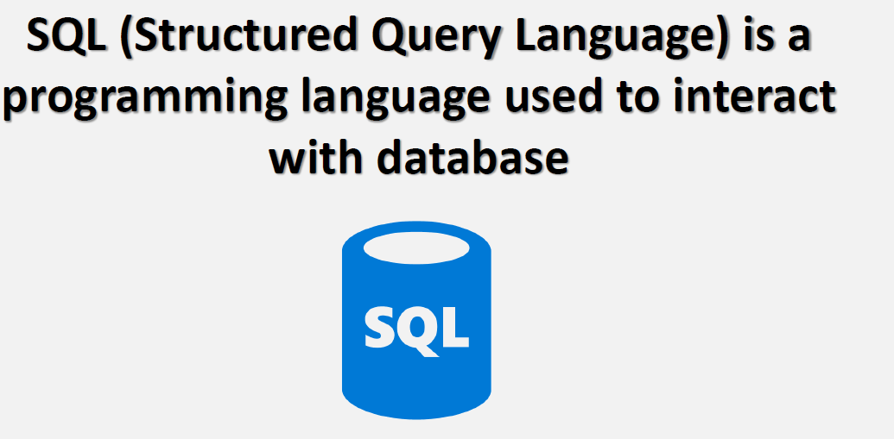
What is SQL?

Slide 6
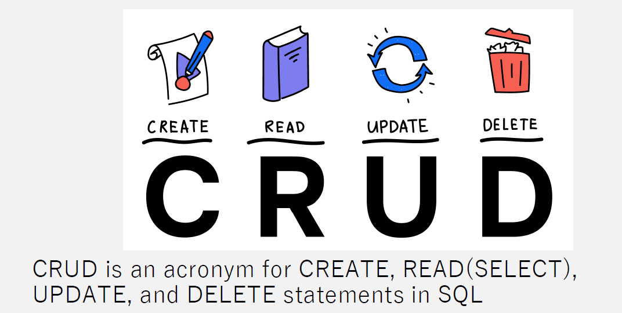
SQL Application:

Slide 7
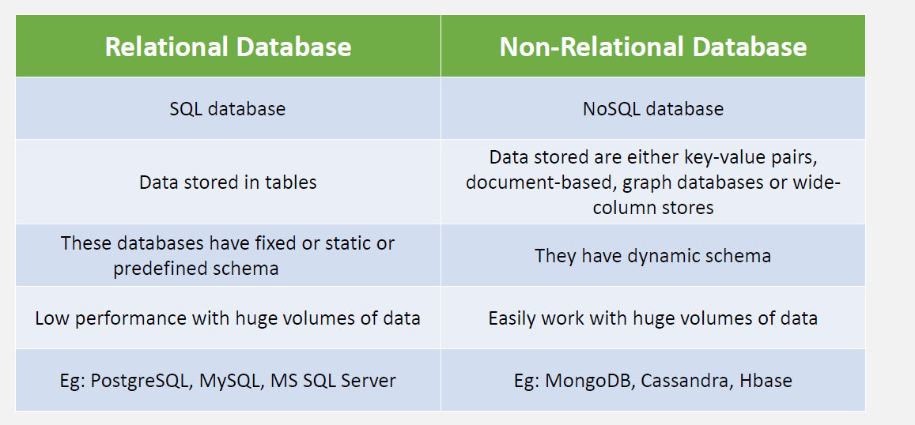
SQL v/s No-sql

Slide 8
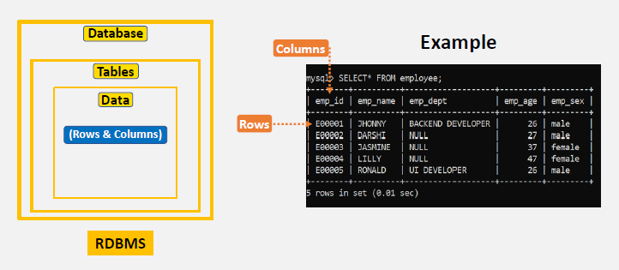
SQL Structure

Slide 9
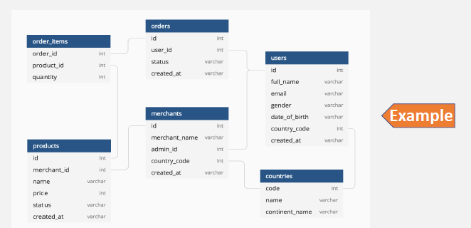
Database Diagram

Slide 10
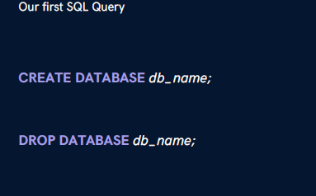
Creating Database

Slide 11
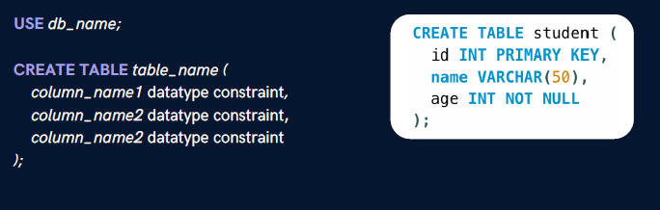
Creating Table

Slide 12
SQL Datatypes:
They define the types of values that can be stored in a column.

Slide 13
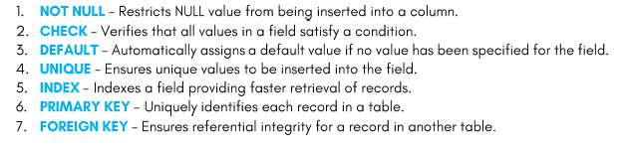
Sql Constraints:
Constraints are used to specify rules for data in a table. This ensures the accuracy and reliability of the data in the table. It can be applied for single and multiple fields in an SQL table.

Slide 14
Primary and Foreign Keys:
Primary key (PK):
A Primary key is a unique column we set in a table to easily identify and locate data in queries
A table can have only one primary key, which should be unique and NOT NULL
Foreign keys (FK):
A Foreign key is a column used to link two or more tables together
A table can have any number of foreign keys, and can contain duplicate and NULL values

Slide 15
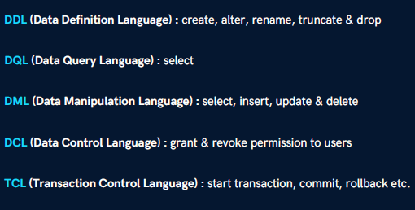
Types of Sql Commands

Slide 16
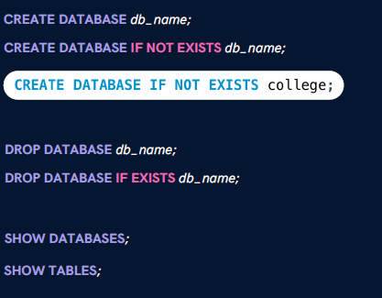
Database Related Queries

Slide 17
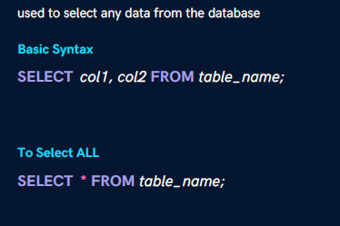
Select (DQl)

Slide 18
Today’s Class topic
SELECT statement
WHERE clause search condition
Arithmetic, Comparison and Logical operator
Range operator (Between, Not between)
List operator (In, not in)

Slide 19
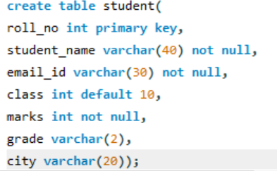
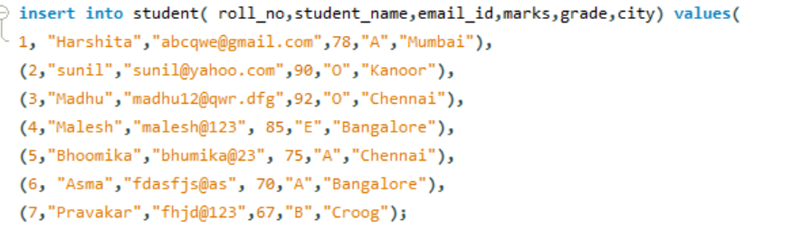
Exercise for class
Make a student table with Column name- roll no, name, marks, grade, city, email-id.

Slide 20
Where Clause
SELECT col1, col2 FROM table_name WHERE conditions;

Slide 21
Operator with Where Clause
Using Operators in WHERE
Arithmetic Operators : +(addition) , -(subtraction), *(multiplication), /(division), %(modulus)
Comparison Operators : = (equal to), != (not equal to), > , >=, <, <=
Logical Operators : AND, OR , NOT, IN, BETWEEN, ALL, LIKE, ANY

Slide 22
Arithmetic Operators
Addition operator:
Subtraction operator:
Multiplication Operator:
Division Operator:

Slide 23
Comparison Operators
= operator:
!= operator:
> operator:

Slide 24
Logical Operator
AND (to check for both conditions to be true)
OR (to check for one of the conditions to be true)
NOT (to negate the given condition)

Slide 25
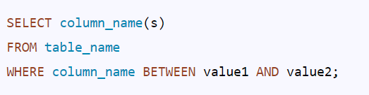
Syntax of the SQL BETWEEN Operator
The BETWEEN is a logical operator in SQL, which fetches the records from the table within the range specified in the query. We can use this operator to select numbers, text, or dates.
We can use it with SELECT, UPDATE, DELETE, INSERT Statement.
The BETWEEN operator in SQL includes the starting and ending values.

Slide 26
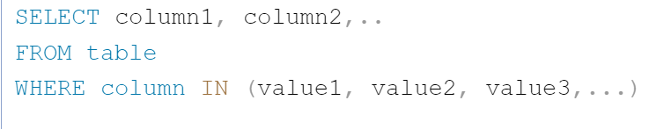
Syntax of the SQL In Operator
IN is an operator in SQL generally used with a WHERE clause.
Using the IN operator, multiple values can be specified. It allows us to easily test if an expression matches any value in a list of values.
IN operator is used to replace many OR conditions.

Slide 27
Like Operator
LIKE condition is used to perform pattern matching to find the correct result. It is used in SELECT, INSERT, UPDATE and DELETE statement with the combination of WHERE clause.
SELECT column1, column2, ... FROM table_name WHERE columnN LIKE pattern;
SELECT * FROM Customers WHERE CustomerName LIKE 'a%';

Slide 28
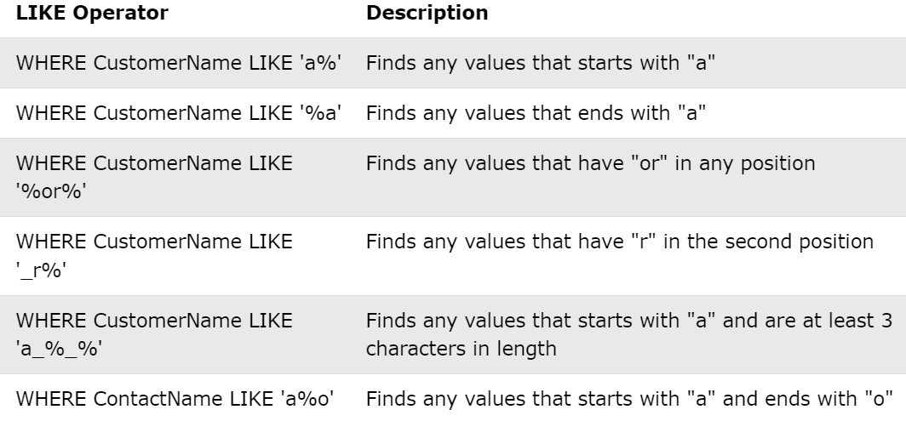
Wildcard Characters in MySQL

Slide 29
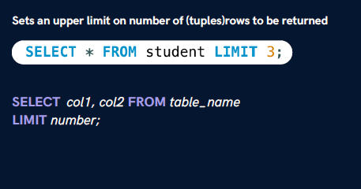
Limit Clause

